Slide 1
School-Aged Violence and Potential Impact on Proportion of Women in Public Office
Maggie Sullivan, Sharon Chuang, Shirui Zhou, Li Zheng

Slide 2
Problem
Despite making up roughly 50 percent of the population, as of December 2021, only five countries (Rwanda, Cuba, Nicaragua, Mexico, and the United Arab Emirates) had women holding over 50 percent of parliamentary seats in the lower or single house (IPU Parline).
According to United Nations Women, “At the current rate of progress, gender parity in national legislative bodies will not be achieved before 2063.”

Slide 3
Short Background/Literature Review
Initially we planned to examine the relationship between online violence against women and women’s political participation.
However, this is an emerging data area and many data gaps remain.
For example, a November Axios article highlighted the formation of a “a first-of-its-kind database” that tracked online violence against government officials (Kingson).

Slide 4
Short Background/Literature Review Contd.
Instead, we pivoted to examine violence in relation to another proposed element contributing to the low numbers of women in elected office: the influence of childhood experiences.
For example, based on survey data from 1,600 children ages 6 to 12, researchers Bos, et al concluded that girls report less interest in running for political office than their boy peers (Bos, Angela L., et al).
Another study by Fox and Lawless found that even factors such as participation in school sports influences whether or not a girl says they want to run for office someday (Fox and Lawless, “Girls Just Wanna Not Run”).
In a separate study, Fox and Lawless also concluded that women’s self-perceived qualifications were statistically significant in whether women considered running for office.

Slide 5
Theory
Gender socialization theory: Fox and Lawless argued that “Gender Socialization Theory” provides a framework to better understand the lack of women in politics, meaning that the traditional exclusion of women from the public sphere continues to have an impact on on current levels of representation (Fox and Lawless, “Entering the Arena?”).
Our hypothesis is that the levels of violence against girls in high school will have a negative correlation on the levels of women in politics at both the state and federal level.

Slide 6
Data and Method
Data pulled from Institute for Women’s Policy Research which compiles detailed data in a project titled “Status of Women in the States.”
2015 Violence and Safety: consists of “available state-level data on the percent of high school students experiencing harassment or bullying and dating violence, and state statutes on violence and employment, domestic violence, sexual violence, stalking, and gun ownership.”
2015 Political Participation: consists of “state-level data on women in congress and state legislatures; women of color in congress, state legislatures and statewide elected offices; and institutional resources.”
Additional datasets for further analysis: 2015 education data, fips data, 2016 election data (states whose electoral votes went to the democratic candidate versus the republican candidate)

Slide 7
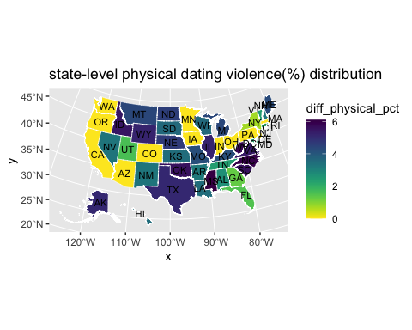
Results: State-Level Distribution of Violence Data

Slide 8
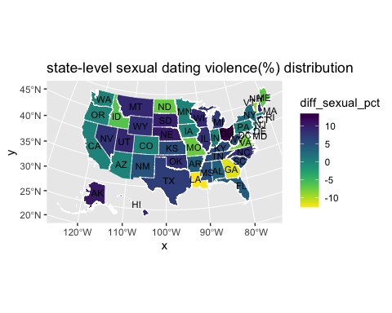
Results: State-Level Distribution of Sexual Dating Violence Differences

Slide 9
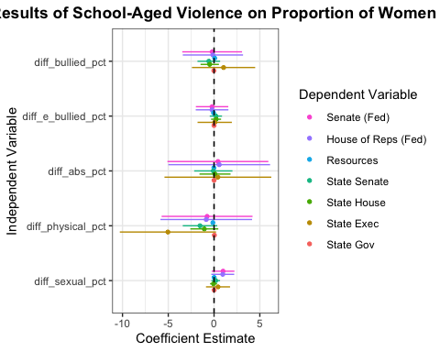
Results: Regression Set 1

Slide 10
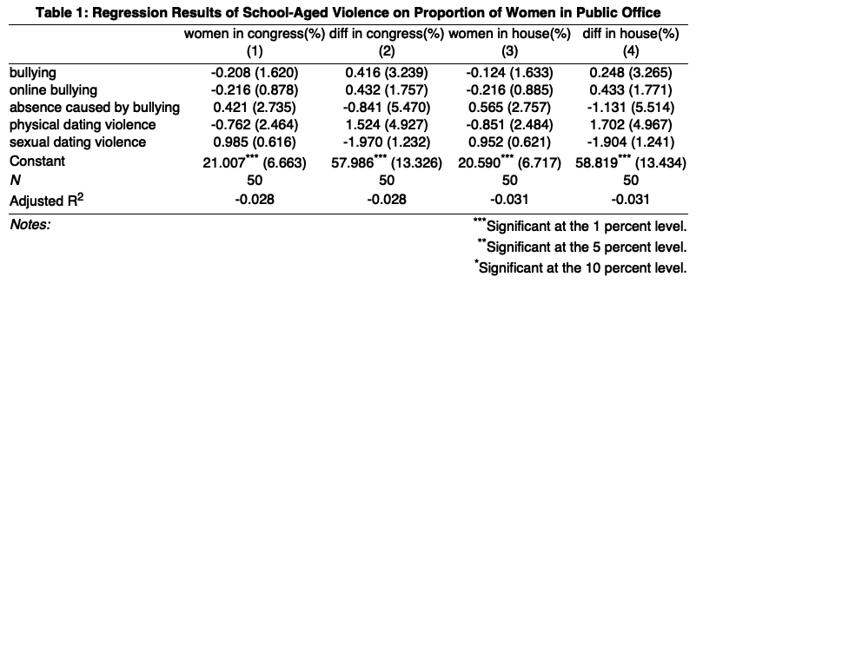
Results: Regression Set 2

Slide 11
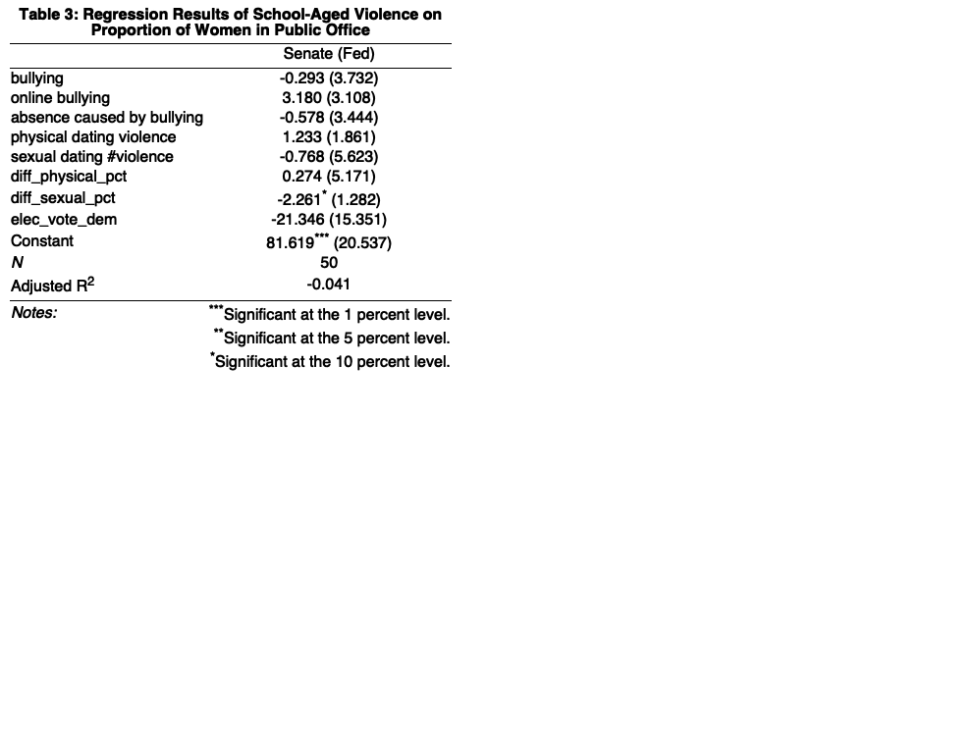
Results: Regression Set 3

Slide 12
Interpretation of the Results
The coefficient of difference percent in experiencing sexual dating violence is significant at 5% level on political participation (both congress and house)
An increase of sexual dating violence with one percent is associated with an increase of political participation difference of 8 percent
The main conclusion is that a relationship between gender gap regarding sexual dating violence and gender gap of political participation reflecting by both the congress and house female and male representative rate

Slide 13
Limitations
Missing data:
The actual domestic violence number is known, because of unreported domestic violence
Awareness of domestic violence is growing, the total amount maybe decrease but the with the reported rate increase we still can’t have the whole trend
The definition of domestic violence has changed over time. For example, intimate partner violence start to be notice until recent days.

Slide 14
Limitations
Reversal Causation:the increasing female representatives and senator can design more policies women violence related policies
Less control variable: the model’s explaining power is weak, r-squared is only 0.11 after adding the control variable

Slide 15
Future Work
missing data time-series analysis: trend and policy environment
adding more demographic characteristic as control variables
two stage least square: do the regression analysis of policy gender gap on the violence first, then the do regression of political participation on the violence

Slide 16
Resources and References
Data:
https://statusofwomendata.org/explore-the-data/download-the-data/
Literature Review
Bos, Angela L., et al. “100 Years of Suffrage and Girls Still Struggle to Find Their ‘Fit’ in Politics.” PS: Political Science & Politics, vol. 53, no. 3, 2020, pp. 474–478., https://doi.org/10.1017/s1049096520000293.https://www.cambridge.org/core/journals/ps-political-science-and-politics/article/abs/100-years-of-suffrage-and-girls-still-struggle-to-find-their-fit-in-politics/32F308992511C57D72E66BD15D190D55
Fox, Richard L., and Jennifer L. Lawless. “Entering the Arena? Gender and the Decision to Run for Office.” American Journal of Political Science, vol. 48, no. 2, 2004, pp. 264–280., https://doi.org/10.1111/j.0092-5853.2004.00069.x. https://onlinelibrary.wiley.com/doi/abs/10.1111/j.0092-5853.2004.00069.x?casa_token=Zw0hs1dj_7AAAAAA%3A6FTbDnoF2rTuPQ9iuYYpwSW4xaAjkH2jl9wUpNlSsbGLgz0c6P9-k4kyjqphFe90aHO1IcOuJRaWY20H
Fox, Richard L., and Jennifer L. Lawless. “Girls Just Wanna Not Run: The Gender Gap in Young Americans’ Political Ambition” https://www.american.edu/spa/wpi/upload/girls-just-wanna-not-run_policy-report.pdf
IPU Parline, “Monthly ranking of women in national parliaments”, https://data.ipu.org/women-ranking?month=12&year=2021
Kingson, Jennifer A. “A first-of-its-kind database tracks threats against public officials.” https://www.axios.com/2022/11/01/princeton-threats-officials-elections-harassment
UN Women, “Facts and figures: Women’s leadership and political participation”, https://www.unwomen.org/en/what-we-do/leadership-and-political-participation/facts-and-figures

